Slide 1

Recursion Tree Method
Nav Sanya Anand

Slide 2
Steps to follow and Points to Note
Convert the recurrence into a tree:
– Each node represents the cost incurred at various levels of recursion
– Sum up the costs of all levels
Point to note:
Height of a tree: ln(n) or log₂(n)

Slide 3
Example 1 - T(n) = c + T(n/2)
c
T(n)
c
T(n/2)
c
T(n/4)
lg(n) or log₂(n)
T(1)
Total Time = c lg(n) Therefore, Θ(lg (n))

Slide 4
Example 2 - T(n) = n + 2T(n/2)
n
T(n)
n/2 +n/2 = n
T(n/2)
T(n/2)
n/4 +n/4 + n/4 + n/4 = n
T(n/4)
T(n/4)
T(n/4)
T(n/4)
lg(n) or log₂(n)
T(1)
Total Time = n lg(n) Therefore, Θ(n lg (n))

Slide 5
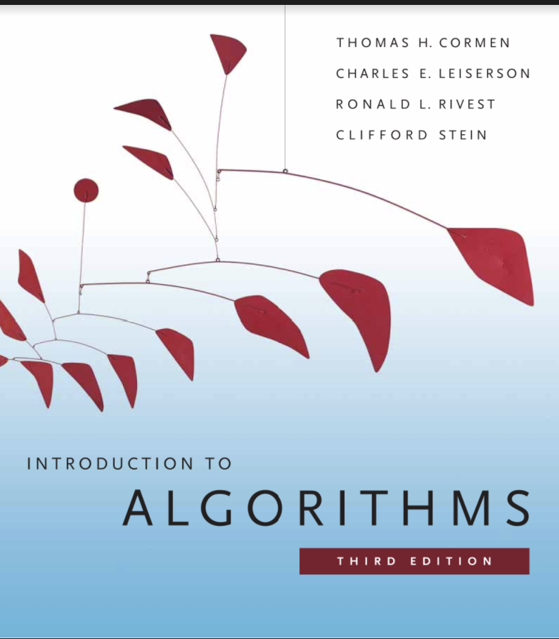
References

